Slide 1


ABU-Hanifa

Slide 2
The Educational Center of Abu-Hanifa
Courses
Teachers
Subscription
Name
About Course
Teacher
Name
Duration
Students
Students
Name
About Teeacher
Subjects
Function

Slide 3
The Educational Center of Abu-Hanifa
Comments
Students
Text
Author
Name
Img
Dislikes
Type
Likes
Date
Name
Subjects
Subject Name
Rate of Students
Img

Slide 4

The Educational Center of Abu-Hanifa

Slide 5
Posts
Text
Img
Author
Date
Views
Comments

Slide 6
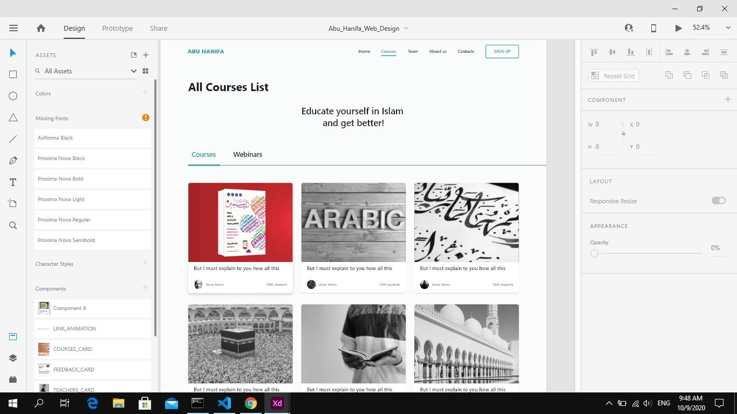

Slide 7
